Slide 1
CS135 Autotest Generator
Sam

Slide 2
Background Information
Autotest VS Public Test:
Autotest: on due date by ISAs. Public Test: after each submission by students
Public Test: small number of tests (1-3 per question)
Autotest: large number of tests (10-20 per question (Fall2013))
Public Test: correct name and syntax
Autotest: correctness (and efficiency for some assignments)

Slide 3
Dilemma between more tests and less debugging
More test cases
-> Higher possibility to find wrong answers
-> More feedbacks to students
-> More time and effort on debugging
-> Less time on other things
-> No time relax (no chatting, playing video games, watching YouTube)
What about:
Less test cases -> less debugging -> everyone gets perfect -> no complaints ☺
-> NO! I will get fired……☹

Slide 4
My thoughts
Sample Solutions (from Instructors/ISAs)
Bang! Lots of test cases are waiting for me!
Inputs (from me)
Autotest Generator

Slide 5
Objectives
Preparations:
1. understand how “rst”(run tests) command works (go to ISG TWIKI. Link: https://cs.uwaterloo.ca/twiki/view/ISG/RST)
2. read and understand the file system of “test.0”(contains all autotests) from AutotestCreationFall2011.docx created by YenTingChen (go to ISG TWIKI. Link: https://cs.uwaterloo.ca/twiki/view/ISG/CompSci135)
3. I will create documentations for my code and user guide later!

Slide 6
Objectives
Autotest Generator is able to handle:
1. different language levels for course CS135:
B (Beginning Student)
BL (Beginning Student w/ List Abb.)
I (Intermediate Student)
IL (Intermediate Student w/ Lambda)

Slide 7
Objectives
Autotest Generator is able to handle:
2. Students’ answers require some teaching pack/user defined packs
3. Set up forbidden functions checking (original code provided by Nick Lee)
4. Set up the test running environment (other important settings for tests)
5. Generate tests for “rst” in several seconds!
6. Generate big data for efficiency test!

Slide 8
Demo – Assignment :)
Assignment :)
Language: Intermediate Student w/ Lambda
Due date: ( there’s no due date
Q1: write a function called sum1, which consumes a list of Nat, and produces the sum of all the elements in that list. (submit “sum1.rkt”)
Eg. (sum1 (list 1 2 3)) => 6 (testgen mode: ‘list)
Q2: write a function called sum2, which consumes a list of Floating Num, and produces the sum of all the elements in that list. Hint: use check-within to test. (submit “sum2.rkt”)
Eg. (sum2 (list -1.1 1.1 2.45)) => 2.45 (testgen mode: ‘list with check-within)
Q3: write a function called tree-copy, which cosumes a BT, and produces a copy of that BT ;;A BT is either empty, or (make-btnode num BT BT) (submit “tree-copy.rkt”)
Eg. (tree-copy (make-btnode 1 empty empty)) => (make-btnode 1 empty empty) (testgen mode: ‘non-list )

Slide 9
Demo – Assignment :)
Q4: (from Fall2013CS135 A10 BONUS)
Write a function called subsets1, which consumes a list of numbers and produces a list of all of its subsets. (submit “subset1.rkt”)
Eg. (subsets1 ’(1 2)) => (list ’(1 2) ’(1) ’(2) ’()). (testgen mode: ‘custom)
Q5: (forbidden functions)
write a function called my-reverse, which consumes a list of any value, and produce that list in reverse order. You cannot use reverse.(submit “my-reverse.rkt”)
Eg. (my-reverse (list 1 2 3)) => (list 3 2 1) (set up forbidden functions)

Slide 10
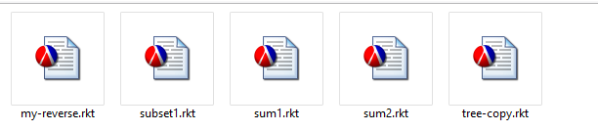
Autotest Generator
1. You need sample solutions

Slide 11
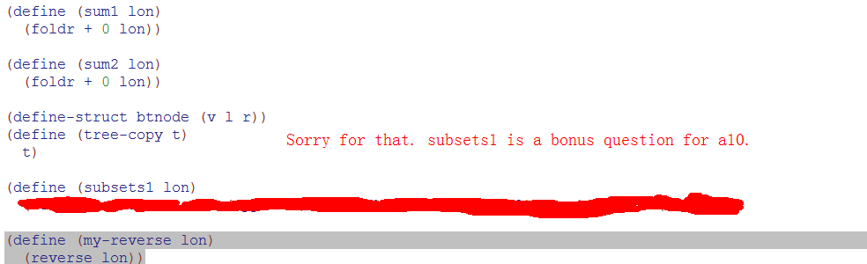
Autotest Generator
2. Copy all solution in one single file (ie. assn.rkt)

Slide 12
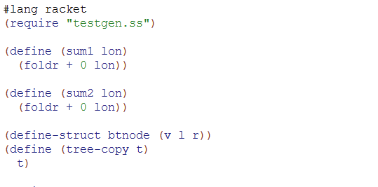
Autotest Generator
2. put testgen.ss into the same directory
change to lang racket
put (require “testgen.ss”) after that

Slide 13
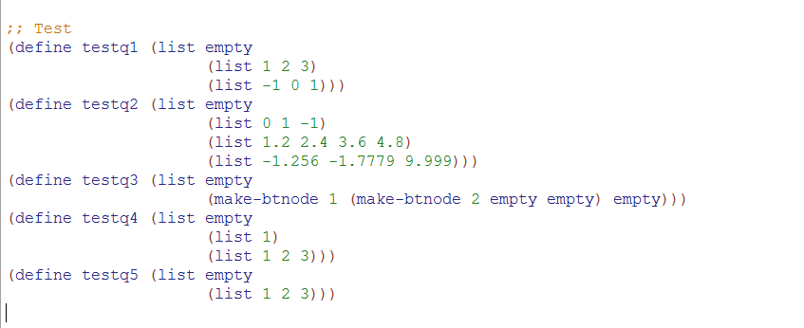
Autotest Generator
3. create test cases (a list of inputs) for each question:

Slide 14
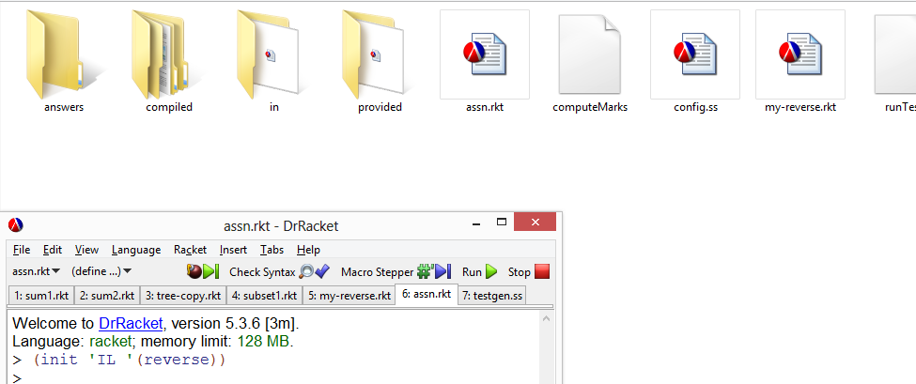
Autotest Generator
3. Initialization (setting up the test environment and forbidden functions):

Slide 15
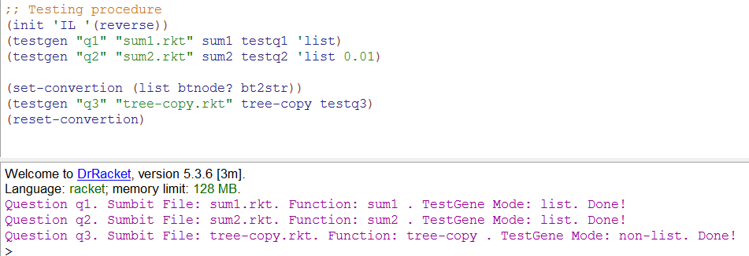
Autotest Generator
3. run testgen for q1-q3:

Slide 16
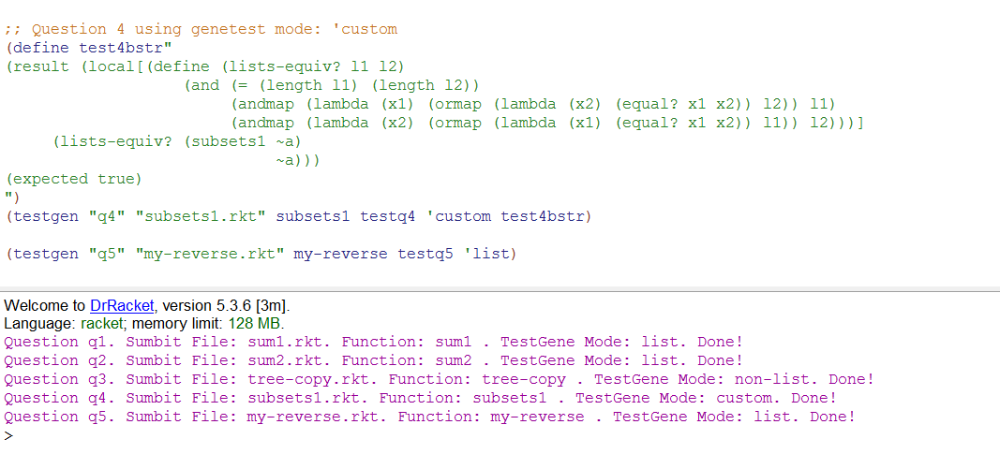
Autotest Generator
4. run testgen for q4-q5:

Slide 17
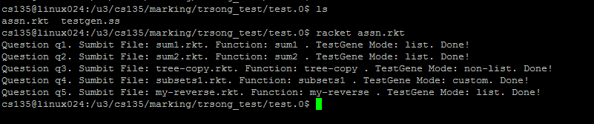
Autotest Generator
5. now copy assn.rkt testgen.ss to course accout and run it!

Slide 18
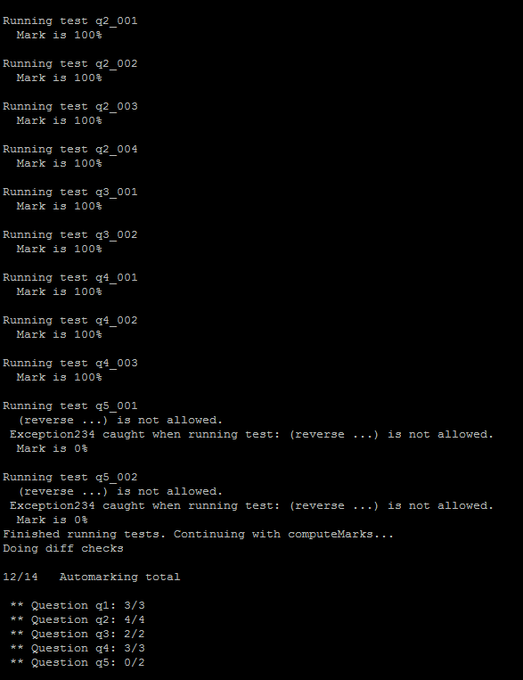
Autotest Generator
5. now submit your solutions, and let’s start testing
For q5 I did use forbidden function “reverse”. It works!

Slide 19
Conclusions
1. Autotest Generator can save us a lot of time and effort if we use it wisely
2. By following this tutorial, anyone can write Autotest for cs135
3. This tutorial also works for CS 115 and part of CS116

Slide 20
Future Work
1. Provide enough documentations / video demos on ISG TWIKI
2. Add “Advance Student” language
3. Debug (I just finish coding, so very little time to debug)

Slide 21
Thank you!
1. Hope you have a fun time being a TUTOR!!!
2. Hope you enjoy this tutorial!

